Slide 1
Winter Term 20/21 Graph Neural Networks Org & Introduction
Prof. Dr. Holger Giese (holger.giese@hpi.uni-potsdam.de)
Christian Medeiros Adriano (christian.adriano@hpi.de) - “Chris”
Sona Ghahremani (sona.Ghahremani@hpi.de )

Slide 2
Lecture topics
Organization and Motivation for Machine Learning on Graphs
Overview of Graph Theory and Network Science (metrics and topology)
Discovering Graph Structures (Clustering, Community)
Message Passing and Node Classification
Graph Representation Learning
Link Analysis - PageRank
Graph Convolutional Neural Networks
Graph Recurrent Networks
Graph Attention Networks
Temporal Graph Neural Networks
Deep Generative Models for Graphs
Cascading behavior and Failure Propagation
Influence maximization
Outbreak minimization
Descriptive models
Prediction models
Intervention models

Slide 3
Plan for the Semester
Phase-1: Foundations and Groundwork (First 3 weeks)
90% of teaching and a few small tasks like setting up the environment, studying datasets, and learning how to use libraries. Lectures happening twice a week and individual meetings on-demand during the week.
Phase-2: Exploration and Exploitation (Short lectures)
30 min teaching and quick project status updates (5-10 min maximum). We will keep having individual meetings on demand.
Phase-3: Consolidation (Last two weeks)
writing the final report, which is a summary of the results that you would have presented in the weekly update meetings.

Slide 4
Project
Team size: tree, two persons or individual
Project proposal in three stages:
1- Abstract (250 words): [Context][Problem][Investigation approach] - in two weeks
2- Related work (2 pages) containing summary and critique – in four weeks
3- Proposal - first draft in six weeks
Detail the problem (what is it, why should I care, why is it difficult)
Describe the dataset (source, size, main features, cite any papers that used it)
Determine the metrics and algorithms to be used (preliminary insights, it can change)
Discuss how you will evaluate your results (benchmarks and null-models)

Slide 5
Datasets and Tools
Datasets
http://networkrepository.com/
https://snap.stanford.edu/data/
https://networkdata.ics.uci.edu/
Tools (sorted by priority)
cuGraph: https://github.com/rapidsai/cugraph (Strongly recommend, fast)
NetworkX: https://networkx.org/documentation/stable/tutorial.html (great coverage of graph algorithms)
Snap for Python: http://snap.stanford.edu/snappy/index.html
Pytorch Geometric: https://pytorch-geometric.readthedocs.io/en/latest/
Github project: https://github.com/orgs/hpi-sam/projects/3

Slide 6
Communicantion Plan
Motive | Content | Medium
Artifacts | Source code, Data Documentation, Wiki | Github - https://github.com/orgs/hpi-sam/
Papers | Copyrighted material | Bib-Admin
Messaging ad hoc | Questions, Suggestions, Sharing | Our Slack group: graph-neural-networks.slack.com
Official communications | Schedule, Orientations | Email
Meetings | Lectures, Status, Work meetings | Zoom, Skype
Emergency | Call, SMS, messaging | Chris mobile number (check my Slack profile)

Slide 7
Grading criteria
To pass the project seminar, we expect sufficient contributions to:
the discussions in meetings (preliminary results and readings)
the experiments
the final report
the final presentation
Grading:
project (60%)
report (30%)
presentation (10%)

Slide 8
Basic Concepts

Slide 9
Types of graphs
Directed
Undirected
Disconnected
Fully connected
A
A
A
A
B
B
B
B
C
C
C
C
D
D
D
D
Directed Acyclic Graph
Multigraph
Bipartite
Cliques
E
A
A
A
A
B
B
B
F
B
C
C
C
D
D
D
C
D
Ego network of A

Slide 10
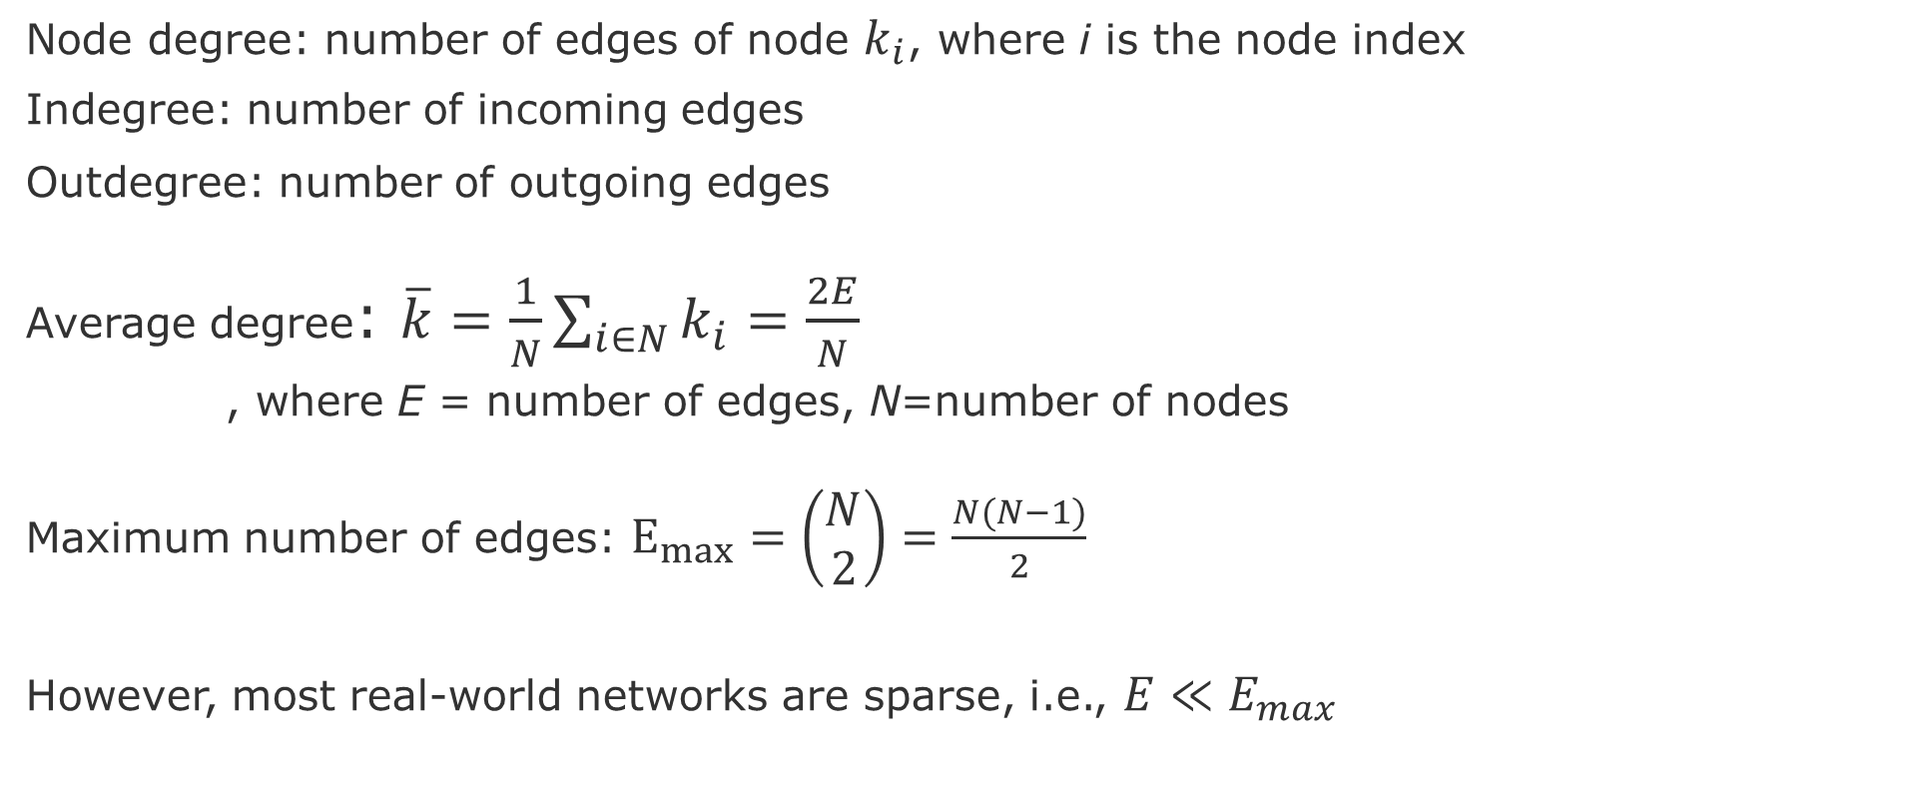
Node and Edge degrees
Node degree: number of edges of node $k_{i}$, where i is the node index
Indegree: number of incoming edges
Outdegree: number of outgoing edges
Average degree: $\overline{k}=\frac{1}{N}\sum_{i∈N}{k_{i}}=\frac{2E}{N}$
, where E = number of edges, N=number of nodes
Maximum number of edges: $E_{max}=\left(\begin{aligned}N \\ 2\end{aligned}\right)=\frac{N(N−1)}{2}$
However, most real-world networks are sparse, i.e., $E≪E_{max}$
Notes:
Leskovec, Jure, et al. "Community structure in large networks: Natural cluster sizes and the absence of large well-defined clusters." Internet Mathematics 6.1 (2009): 29-123.

Slide 11
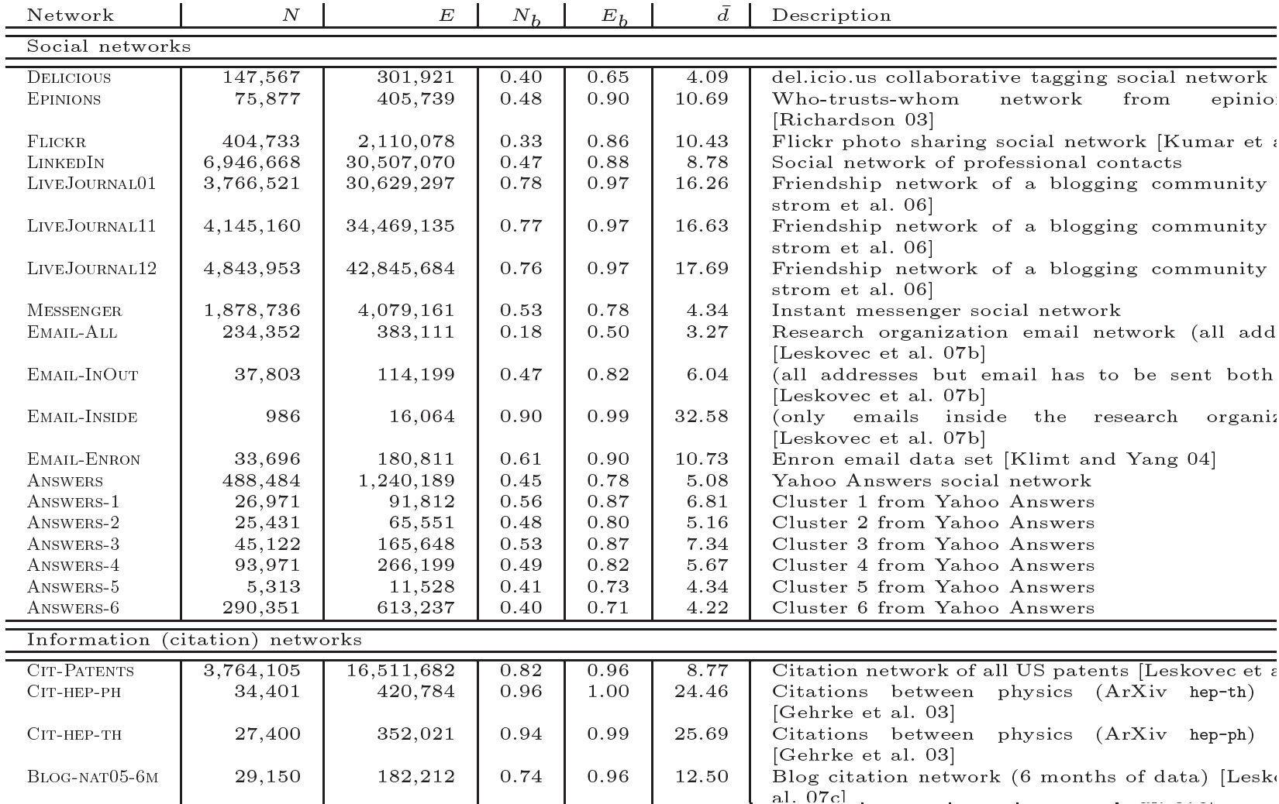

Most real-world networks are sparse
$\overline{d}=$ $\overline{k}=average degree$
source :Leskovec, J., et al. "Community structure in large networks: Natural cluster sizes and the absence of large well-defined clusters." Internet Mathematics 6.1 (2009): 29-123.

Slide 12
Adjacency matrix
 | A | C | D | B | E | F
A | 1 | 1 | 1 | 1 | 0 | 0
C | 1 | 0 | 1 | 1 | 0 | 0
D | 1 | 1 | 0 | 1 | 0 | 0
B | 1 | 1 | 1 | 0 | 1 | 1
E | 0 | 0 | 0 | 1 | 0 | 1
F | 0 | 0 | 0 | 1 | 1 | 0
Cliques
E
A
F
B
C
D
However, adjacency matrix of real-world networks are full of zeros

Slide 13
Motivation for Learning on Graphs and GNNs

Slide 14
Scenarios and Network Types
Network Types
Event graphs
Disease pathways
Knowledge-graphs
Scene graphs
Heterogeneous graphs (different types of nodes and edges)
Scenarios
Clustering in Social network
Protein interaction
Cell similarity networks
Failure propagation in infrastructure networks
Fake news detection
Side-effects of drugs
Network attacks
Traffic jams

Slide 15
Types of Predictions
Node classification
What type of node is this?
Link prediction
Are these two nodes connected?
With which strength?
Graph Classification
Patterns of connectivity (motifs)
Network similarity (isomorphism)
Notes:
Leskovec, Jure, et al. "Community structure in large networks: Natural cluster sizes and the absence of large well-defined clusters." Internet Mathematics 6.1 (2009): 29-123.

Slide 16
Next steps
Lecture-2: Overview of Graph Theory and Network Science (Wed 13h30 - 15h00)
Degree Distribution
Path length
Clustering Coefficient
Null-Models for Graphs
First task:
Accept Slack invitation
Study datasets
See examples of use of Snap or NetworkX
Think of scenarios

Slide 17
END

